Slide 1



Marketing club: meta ads

Slide 2
Agenda
Best Practices
Intro to Ads Manager
  Creating Campaigns
  Making Ad Sets
  Creating Your Ad

Slide 3
Meta Ads
Best Practices
Test, test, and test again!
Patience is key. They won’t all be hits, but keep at it and use the results to guide your next ad.
Your first build or repair didn’t go perfectly, this won’t either. It’s a learning process.
The key to winning is sticking with it. This WILL work, but it takes patience.
Use carefully thought-out creative (image or video).
This guide gives you the design specifications for all forms of creative.
Make sure you have a personal Facebook profile AND a business page.
Know your audience.
Who are you targeting? What are their interests? Are they local only or more global?

Slide 4
Meta Ads
Intro to Ads Manager
Step 1: Log into your Facebook account (or create one if you don’t already have one)
  You’ll need a personal Facebook account to access Ads Manager.
  You can link your business’s page if you haven’t already (we can do this later).
Step 2: Go to Ads Manager
  Use your personal ad account by going to Ads Manager on the left side of the window (desktop).
Step 3: Create a New Campaign
  Choose your campaign objective (traffic vs. engagement vs. leads).
  Select recommended settings. This will optimize your placements and be simpler to set up.
  Add your campaign name (use something you’ll remember in the future).
  Set your budget ($5-20 daily) and turn on the Advantage Campaign Budget.
  Set the date range.
Step 4: Create Your Ad Set
  Name it something recognizable and memorable.
  Choose where you want to drive traffic.
  Set location and minimum age.
  Select relevant audience interests.
Step 5: Create Your Ad
  Name it something distinct to the creative (image or video) you’ll be using.
  Select the page(s) you want connected to the ad.
  Add the ad destination (website, Instagram profile, etc.).
Step 6: Set Up Your Creative
  Add your image or video.
  Add your primary text (up to 5 variations).
  Select your call-to-action (learn more, etc.).
  Add your headline (up to 5 variations). Keep it short and sweet.
Step 7: Review & Publish

Slide 5
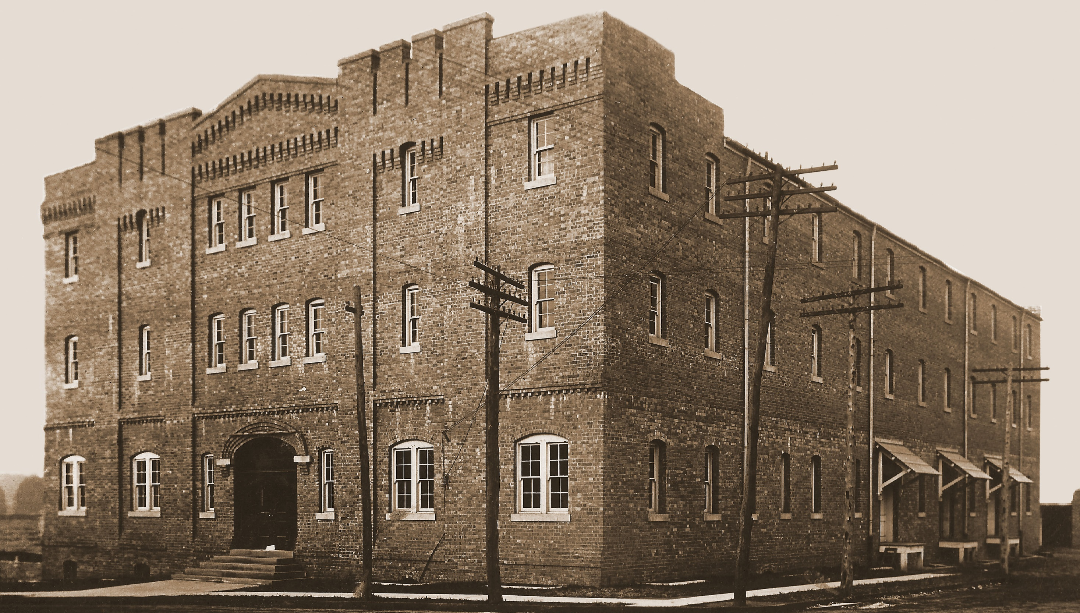

Thank YOU!

